Slide 1

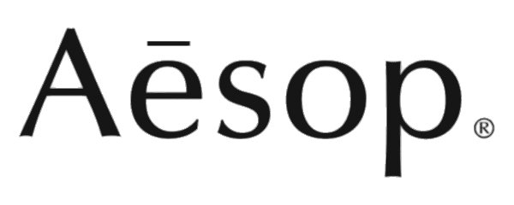
Brand Audit
– From Ritual Luxury to Real Skin Value
Student’s name: Ge Gao (Judy)
Student number: Z5558704
Date: 21/11/2025

Slide 2

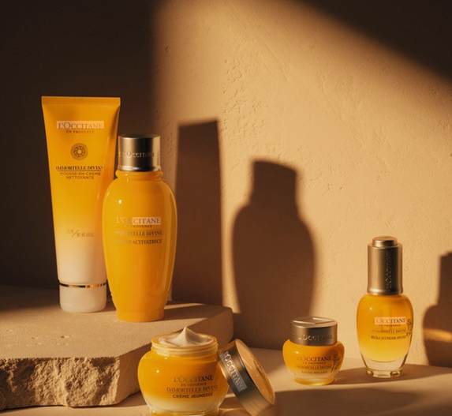
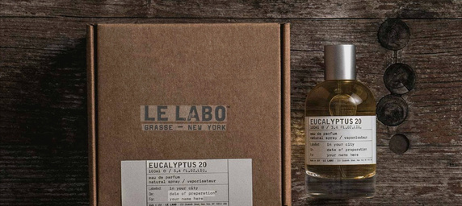
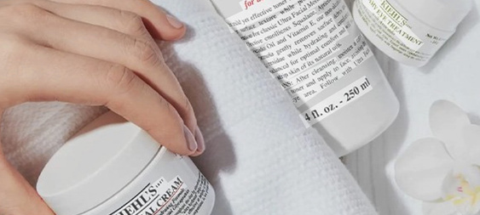
Aesop promises sensory-driven, meticulous care through plant-based + lab-crafted formulas, offering a premium, calming self-care experience
About
Gallery
Home
Aesop
Brand Promise
  Brand promise:
“Aesop presents itself as offering meticulous formulations for skin, hair and body that combine plant-based and lab-made ingredients, with a focus on sensory pleasure and care.”
  Target audience：
“Urban, design-conscious consumers in their 20s–40s who value aesthetics, calm self-care rituals and are willing to pay premium prices.”
  Main competitors:
other premium lifestyle skincare brands such as Kiehl’s, L’Occitane and Le Labo.”
Sensory-driven & meticulous care
Via plant-based + lab-crafted formulas
Delivering a premium, calming self-care experience
Background
Brand Promise Target Audience
&
Competitors
Target Audience
Urban, design-conscious consumers (20s–40s)
Seeking aesthetic self-care rituals & willing to pay premium prices
Main Competitors
Premium lifestyle skincare brand
→ incl. Kiehl’s, L’Occitane, Le Labo
Main competitors

Slide 3

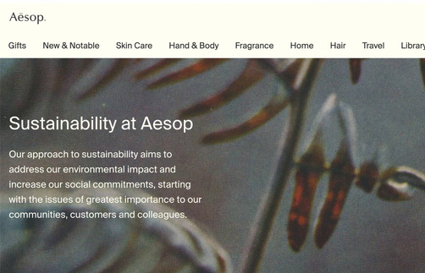
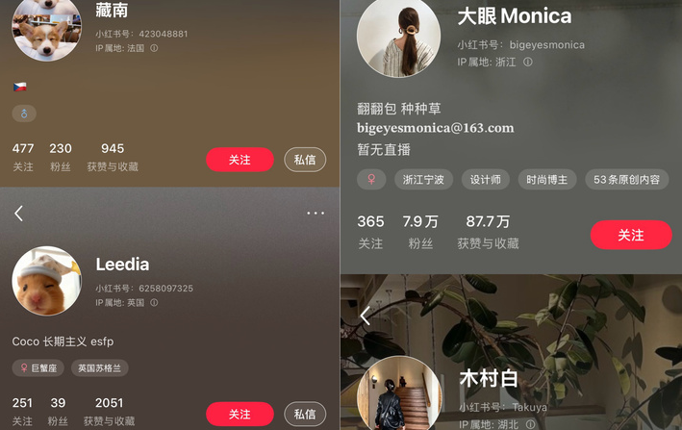
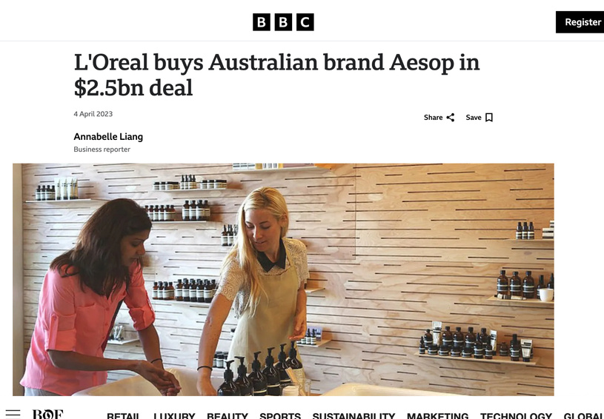
Desk Research
1
Aesop positions itself as a calming, ritual-based premium care brand
→ Using botanical + sustainability cues to signal premium quality & moral sophistication
Source: Aesop official site
2
Consumers admire Aesop’s aesthetic identity, but question value vs. performance
→ Online discussions label some products as ‘IQ tax’, suggesting luxury aesthetics＞functional performance
Source: Focus Group (n=10)
3
Media frame Aesop as a ‘cult premium brand’, but not an expectation-delivery match
→ Many feel the sensory storytelling ＞ functional results, creating an expectation-delivery gap
Source: Business news

Slide 4


  2 Focus Groups (n=10)
  Sampling aligned with Week 6 guideline: Variation in usage & loyalty, but similar category (premium skincare) & spending power
  Semi-structured discussions on first contact, ritual, feelings, value-price, loyalty/exit
  Participants were existing or past Aesop users
  Pre-task: Bring Aesop product/photos + write short ‘love or hate’ note
  This design linked desk research (brand story) with real user experience
Research approach

Slide 5
Focus group design & participants
Group number | Participant | Age | Last purchase | Existing customer?
1 | fashion blogger | 23 | 12/11/2025 | Yes
1 | fashion blogger | 21 | 10/11/2025 | Yes
1 | beauty blogger | 25 | 30/10/2025 | Yes
1 | Chinese student | 20 | < 6 month | New customer
1 | people started working | 24 | 04/11/2025 | New customer
2 | International student | 19 | 21/03/2025 | Yes
2 | working adults | 32 | < 1 year | lapsed
2 | International student | 26 | 18/05/2025 | Yes
2 | Regular customer | 27 | > 2 year | stop buy
2 | working adults | 35 | > 1 year | lapsed

Slide 6

Research objectives
1
  Clarify brand promise Aesop makes to consumers → CBBE “brand meaning”
  Clarify brand promise Aesop makes to consumers → CBBE “brand meaning”
  Explore how different user groups actually experience Aesop (10 participants, 2 focus groups)
  Identify strengths, weaknesses and gaps between promise and delivery
  Generate communication solutions to strengthen customer-based brand equity and reduce “IQ tax” perceptions
2
  Explore how different user groups actually experience Aesop (n=10)
3
  Identify strengths, weaknesses and gaps between promise and delivery
4
  Generate communication solutions to strengthen customer-based brand equity and reduce “IQ tax” perceptions

Slide 7
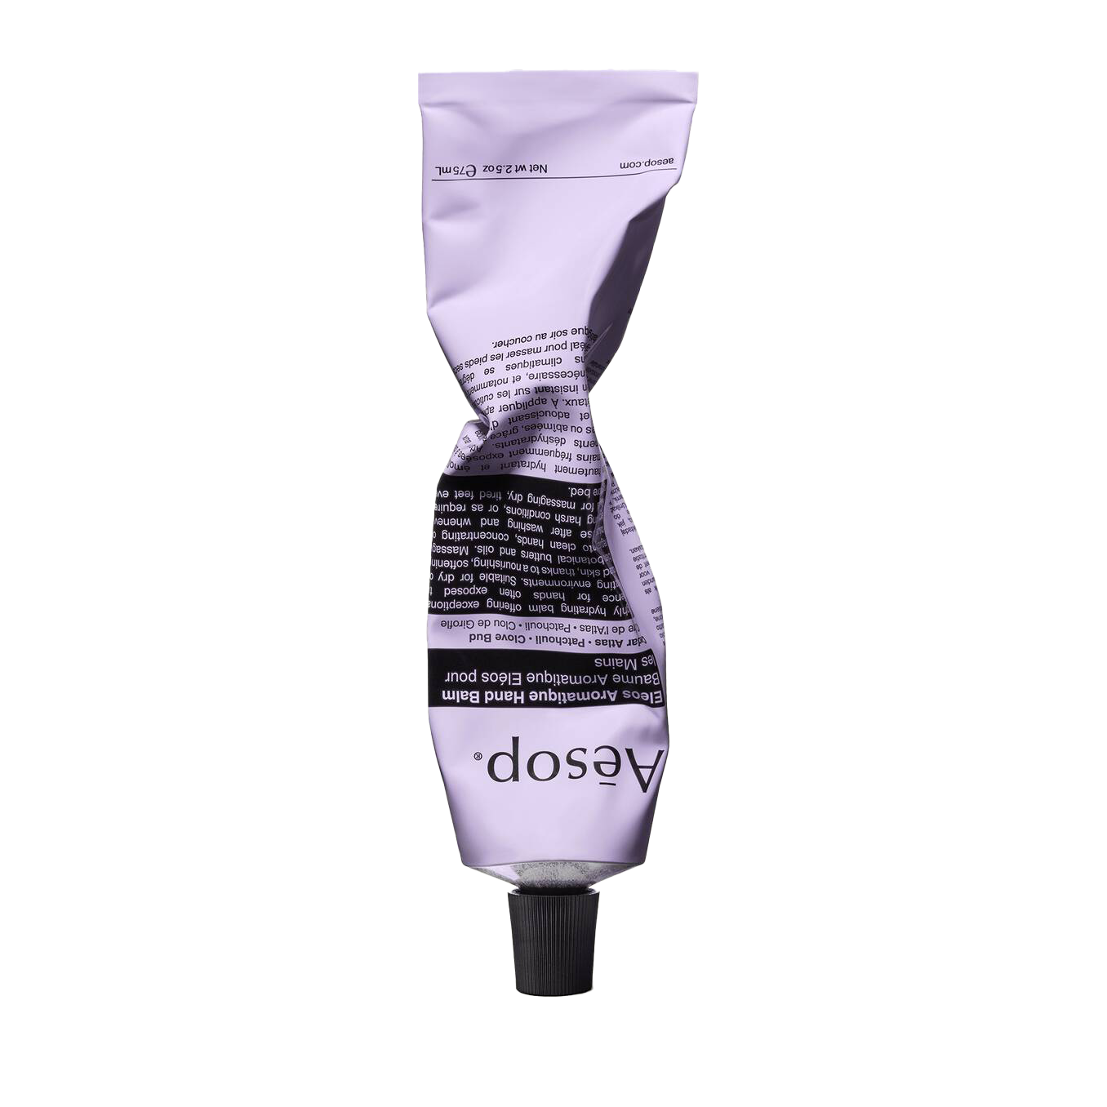
Data Collection
Anaylsis
Frameworks：
Used open, non-leading questions
Used SWOT and the CBBE pyramid to organise findings.
Sessions recorded, translated and coded into themes (promise, sensory experience, efficacy, price–value, trust)
Segment Comparison：
Compared bloggers, students, working adults and ex-customers.
Two focus groups recorded (audio + screenshots)

Slide 8

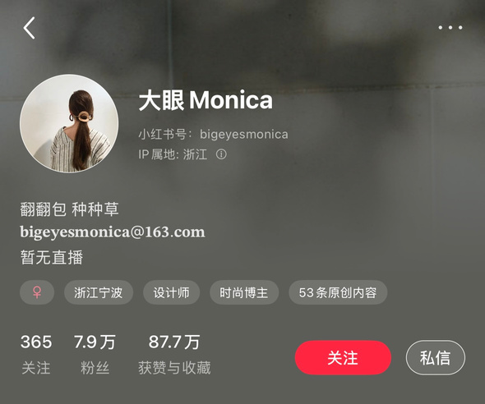


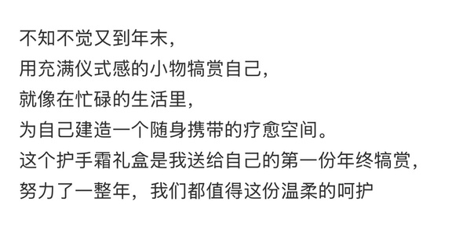
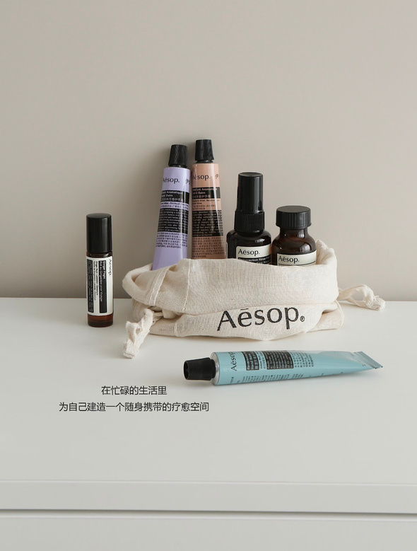
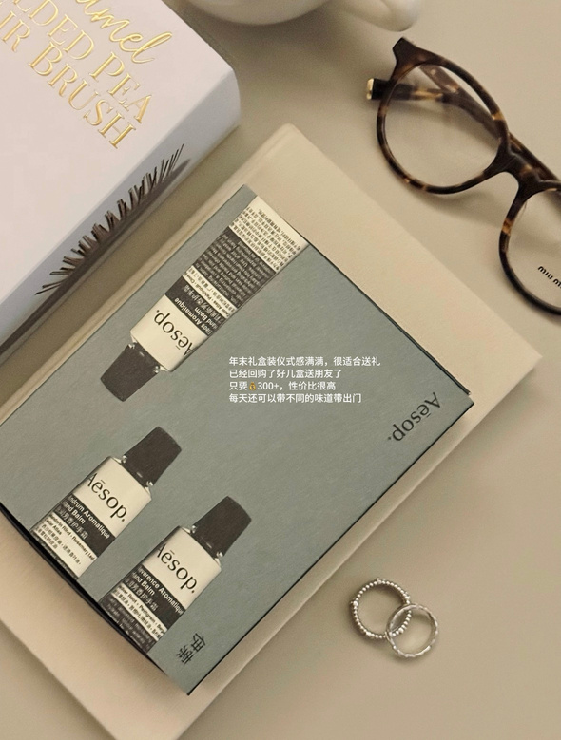
Aesop as “Portable Healing Space”
Users interpret Aesop’s promise as gentle, natural, intelligent care and a calm self-care ritual
They use words like “ritual”, “healing”, “slow luxury” and expect gentle, effective, natural care to justify the price
  “Users read Aesop’s promise as gentle, natural, intelligent care and a calm self-care ritual.”
  Words used: “ritual”, “healing”, “literary”, “slow luxury”, “aesthetic lifestyle brand”
  Expectation: gentle, effective, natural care that justifies high price
  For many, Aesop =
“a portable healing space in a busy life”
“The year-end gift box is full of a sense of ceremony”
(Translated from the feedback of the respondents）
For many, Aesop =
“a portable healing space in a busy life”
“The year-end gift box is full of a sense of ceremony.”
---FG
Fashion blogger & Feedback
Image feedback

Slide 9

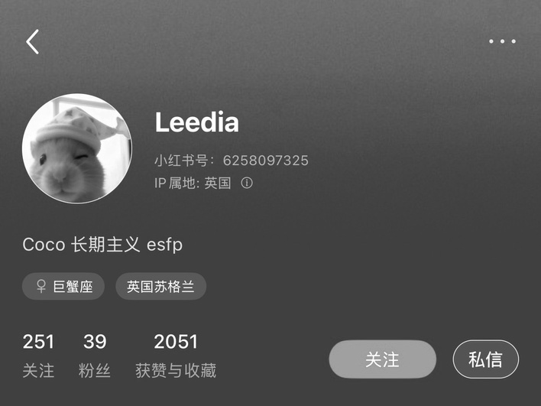
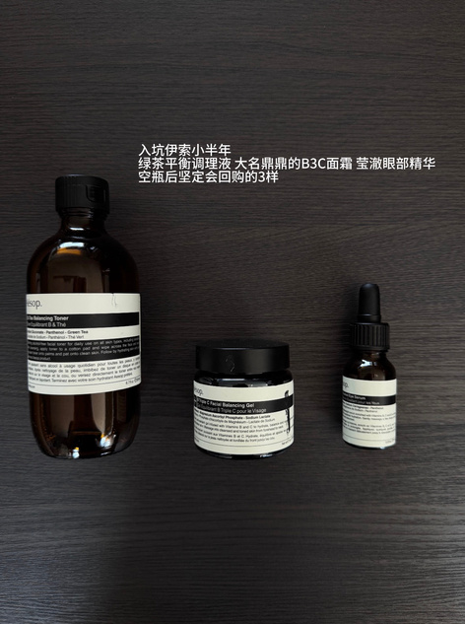
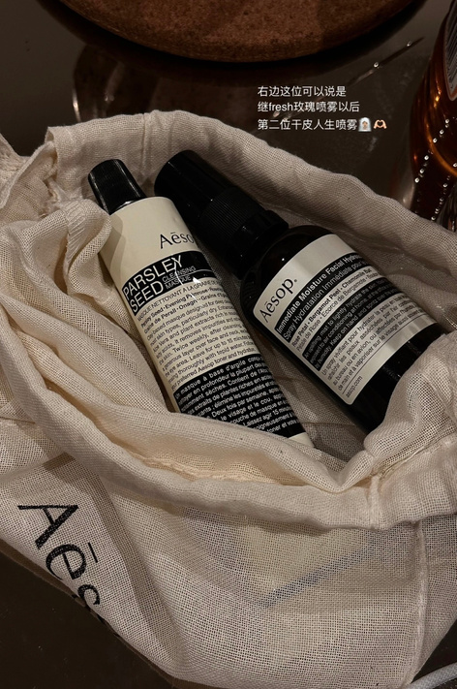
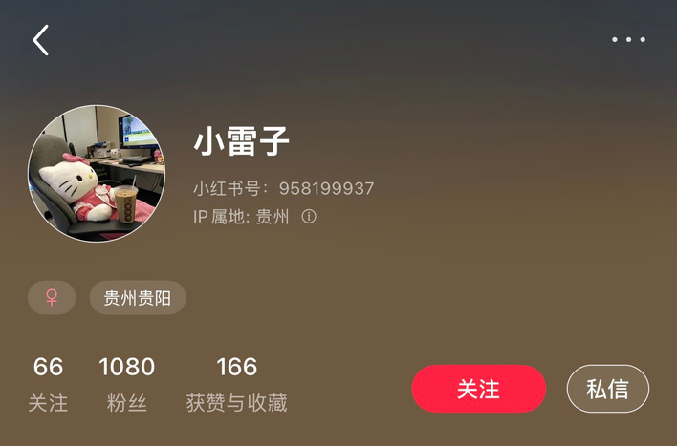
Positive Experiences: Loved for Scent, Design & Gifting
Users love face creams, essences and moisturising sprays, calling one the “best face cream I’ve ever used” and saying they will “definitely repurchase after an empty bottle”.
  Loved categories: Face cream, facial essence, moisturising spray
  Described as “best face cream I’ve ever used”, “smells like spa”, “bottle looks like an art object”
  Strong role in self-reward rituals and gifting to friends / colleagues
“This is a gift from a friend. It can be said to be a dry skin life spray”
“Green Tea Balance Conditioning Liquid, the renowned B3C Face Cream, and the Clear Eye Serum that I will definitely repurchase after an empty bottle”
(Translated from the feedback of the respondents）
They praise “smells like spa”, “bottle looks like an art object”.
They often use Aesop as special gifts for friends and colleagues.

Slide 10
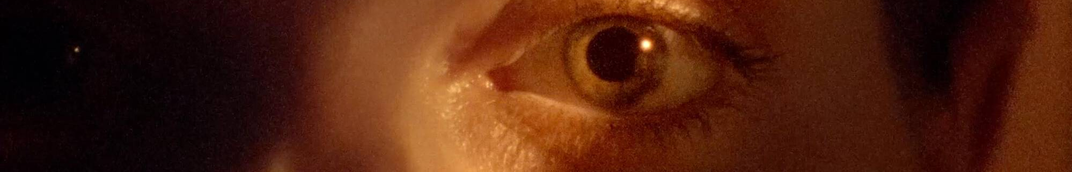
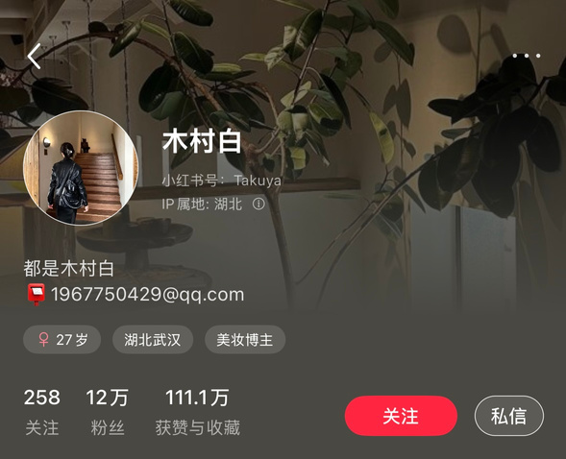

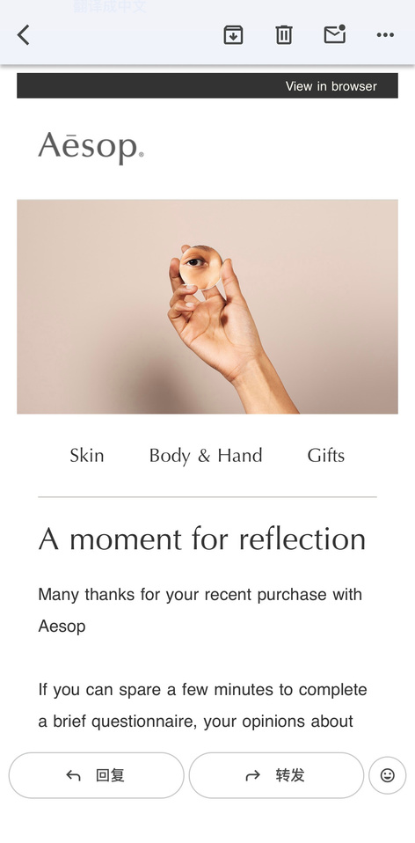
International students and people start working
& Feedback
  Store environment: warm lighting, wood & herbal scent → “I always walk in if I see a store”
(Translated from the feedback of the respondents）
  Staff consultation seen as professional and not too pushy
  One respondent praised post-purchase email survey: “feels like they really care about feedback”
(Translated from the feedback of the respondents）
Positive Experiences: Store & Service
Store environment: warm lighting, wood & herbal scent → “I always walk in if I see a store”
One respondent praised post-purchase email survey: “feels like they really care about feedback”
Beauty blogger & Feedback
Staff consultation seen as professional and not too pushy
Store environment: warm lighting, wood & herbal scent → “I always walk in if I see a store”
Staff consultation seen as professional and not too pushy
One respondent praised post-purchase email survey: “feels like they really care about feedback”
Image feedback

Slide 11
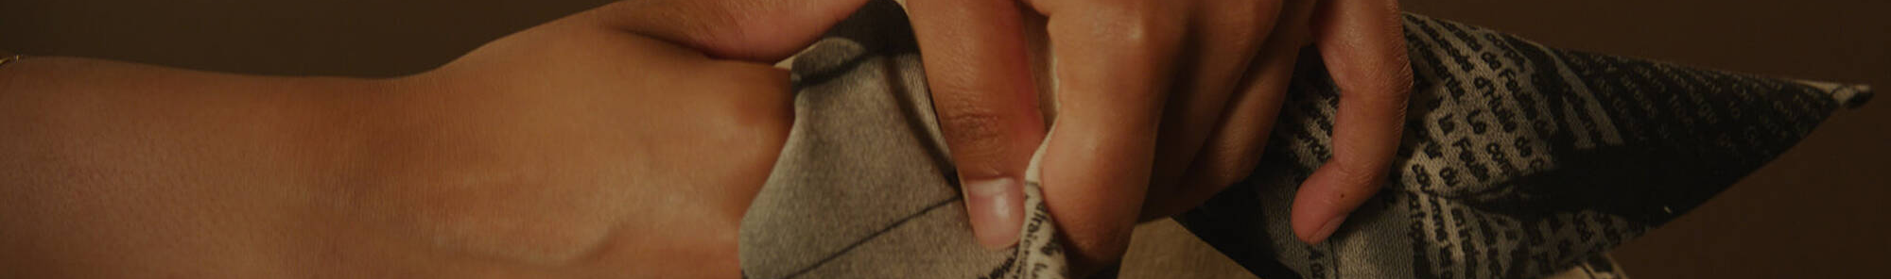
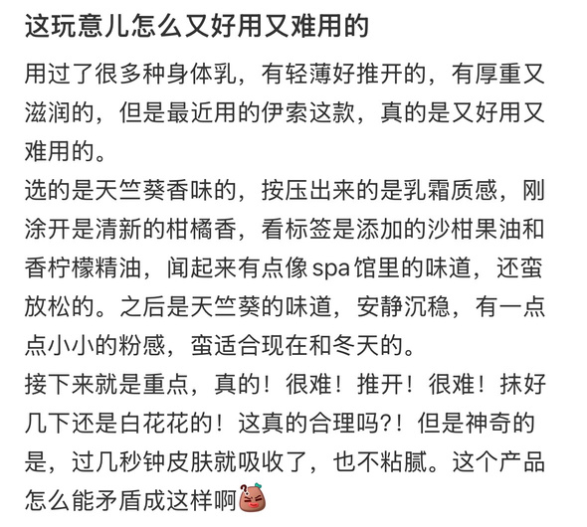
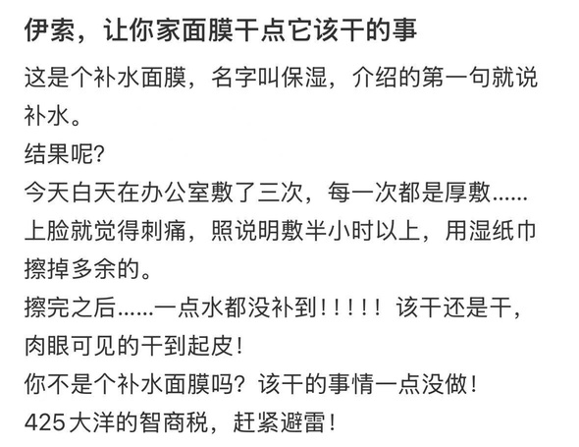
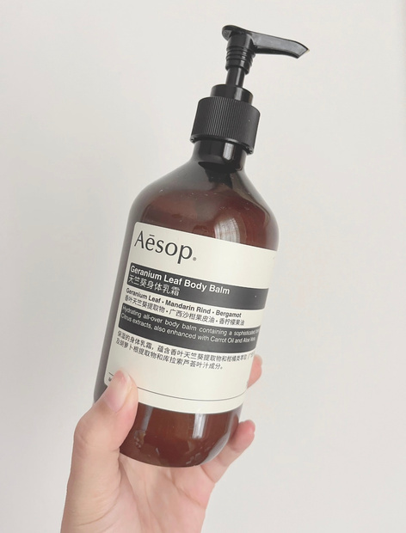
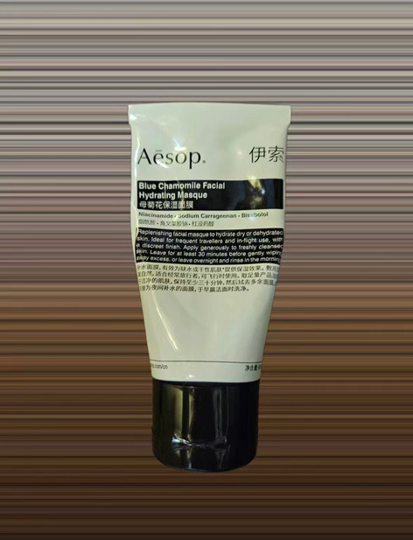
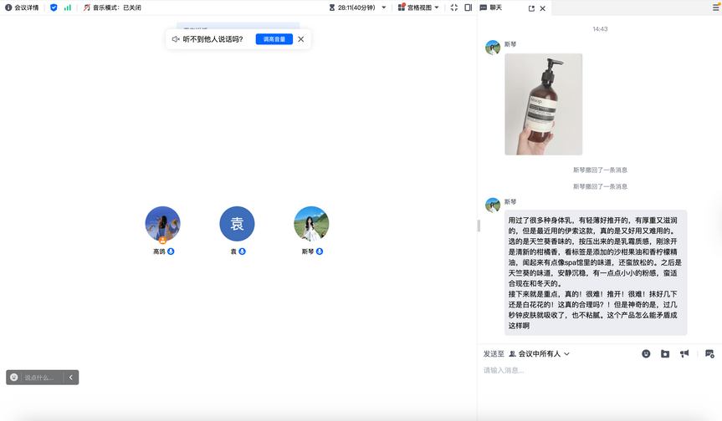
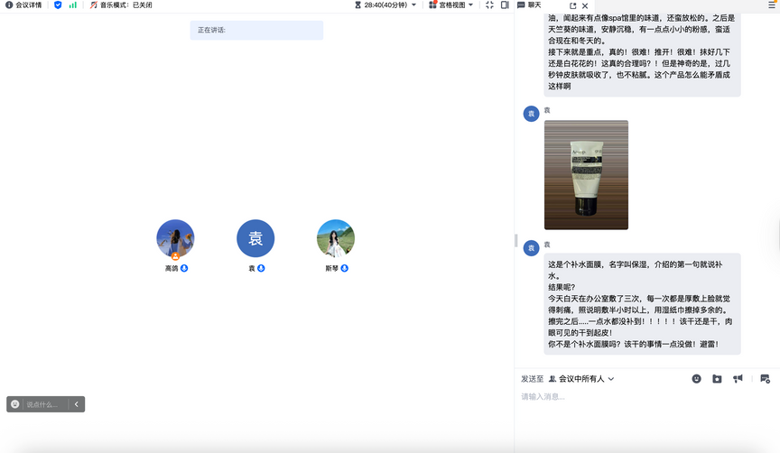
Image feedback
Weak Performance: Looks Premium, but Hydration often Disappoints
Users repeatedly criticised Geranium Leaf Body Balm and some creams as “hard to spread”, “still a white layer after massaging”, “skin still dry next day.”
Blue Chamomile Hydrating Masque: “stings, does nothing, my skin looked even drier”
There is a clear gap between the “deep hydration” claim and real effect, making many feel the products don’t live up to the promise.
working adults & Feedback

Slide 12

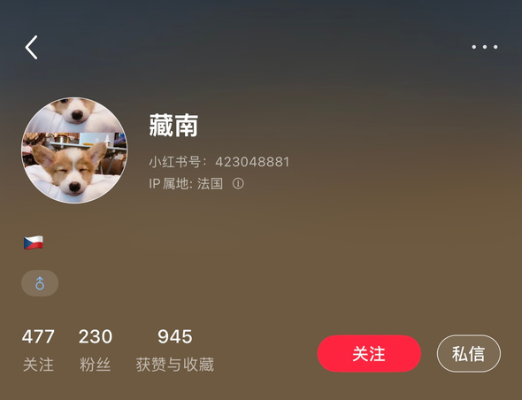
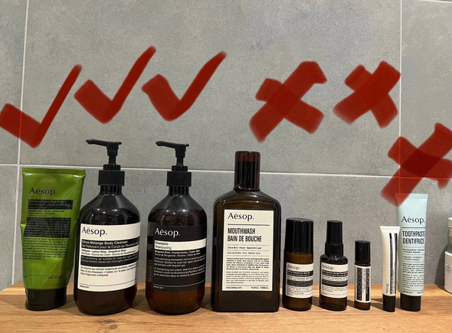
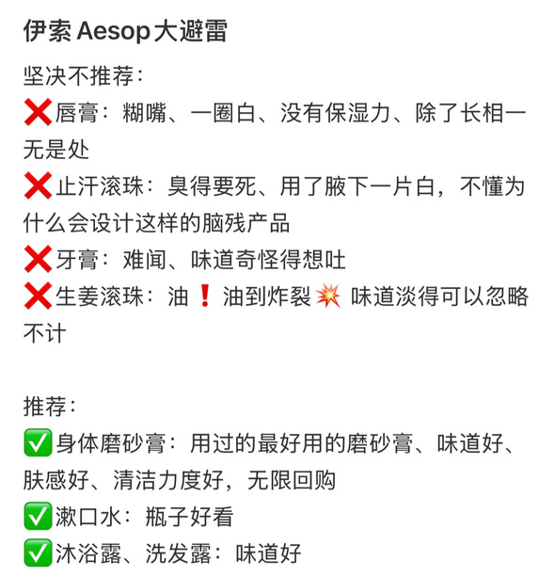
“Big Avoid List” Products:
‘All Packaging, No Effect’
Lip balm, deodorant, toothpaste, ginger body oil described as:
“sticky”, “smells weird”, “embarrassing white cast”, “why would anyone design this?”
This fuels the “Aesop is all packaging, no effect” narrative among potential new users

Slide 13


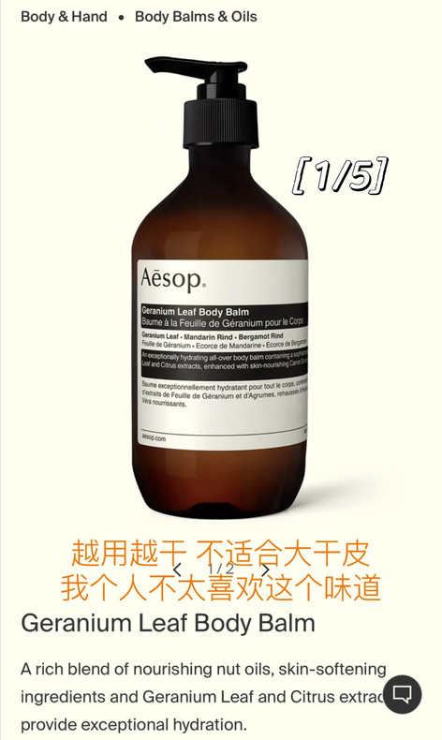
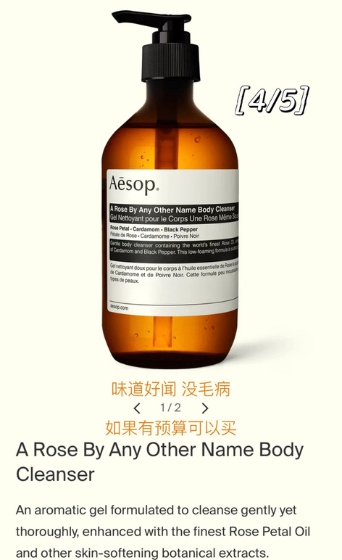
Price–Value & ‘IQ tax’ Narrative
  Many users say they paid for design, story and gifting value, not for visible skin improvement
  Phrases like “425 dollars of IQ tax”, “I bought it for the bathroom photo”
(Translated from the feedback of the respondents）
  Especially strong among international students with limited budget
  This discourse spreads quickly on social media platforms, shaping expectations before people even try Aesop
Many users say they paid for design, story and gifting value, not for visible skin improvement
Phrases like “425 dollars of IQ tax”, “I bought it for the bathroom photo”
Especially strong among international students with limited budget
This discourse spreads quickly on social media platforms, shaping expectations before people even try Aesop

Slide 14

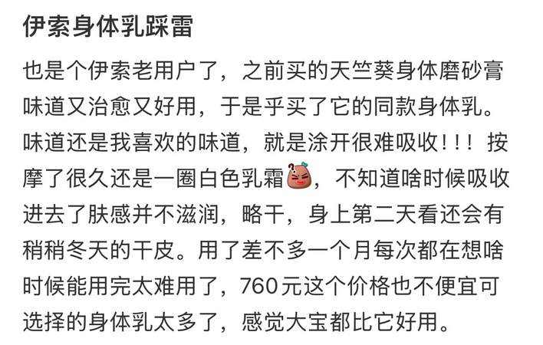
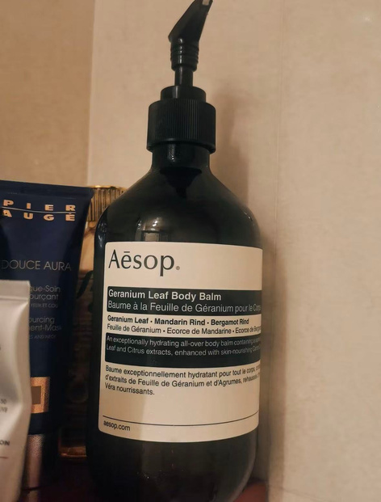
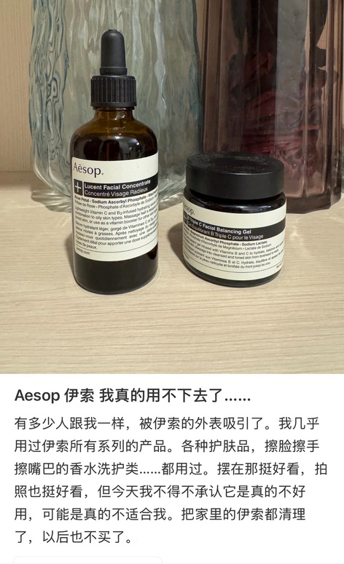
From Love to Exit:
“Not Good Enough to Re-buy”
  Ex-loyalist bought “almost all series” over years but now clearing Aesop out:
  Feels products “look good on shelf, not on skin”
  Keeps only a few hand / body items; has shifted skincare budget to “more scientific” brands
(Translated from the feedback of the respondents）
  Illustrates fragile top of CBBE pyramid: high salience and imagery, but weak long-term resonance
  Interviews with regular customers - Excerpts：Link: https://youtu.be/LJe6Iv2Jsfg
An ex-loyalist who bought “almost all series” over years is now clearing Aesop out, saying products “look good on shelf, not on skin.”
She keeps only a few hand/body items and has shifted her skincare budget to “more scientific” brands
Exposing a fragile CBBE top: strong salience, weak long-term resonance.

Slide 15

Aesop
About
Gallery
Home
Segment differences & promise vs delivery
Bloggers / experienced users:
selective loyalty – keep ritual and scent categories, avoid problem SKUs
Students / new users:
fast cycle from curiosity → disappointment → “never again”
Overall:
strong imagery & feelings, mixed performance & judgments → brand equity at risk if promise stays vague
User type | Promise they buy into | How it actually delivers | Resulting attitude
Bloggers | Ritual, image, gifts, “portable healing” | Love scent and aesthetics; avoid specific weak SKUs | Selective loyalty(keep some, drop others)
Students | “Intelligent natural care” at premium price | often dryness/ irritation; feel performance doesn’t match price | Fast exit,talk about “IQ tax”
Working Adults | Calm self-care after work, quiet luxury | Mixed: enjoy mood/scent, but question effect vs price | Cautious use; some reduced or stop buying

Slide 16
Aesop
About
Gallery
Home
SWOT summary
  S: Distinctive minimalist identity & coherent store design
  S: Strong brand recognition in premium skincare and lifestyle segment
  O: Classify the products clearly according to people's different needs; use science + stories together
  O: Use owned retail + service style to educate, set realistic expectations, collect feedback
  W: Inconsistent functional performance and high price makes disappointment feel like betrayal (‘IQ tax’)
  W: Over-reliance on fragrance + vague benefit claims; limited visible response to negative reviews
  T: Premium skincare crowded with active-rich competitors and cheaper dupes
  T: Social media “call-out” culture; negative lists (“Aesop big avoid list”) spread fast

Slide 17

Aesop
About
Gallery
Home
strong with ritual-oriented, normal-skin users; fragile with dry-skin and value-sensitive users
Resonance
Judgments & Feelings
love of store and scent vs frustration with some products and price–value
CBBE view: where Aesop is strong vs fragile
Performance & Imagery
design, scent, store rituals create rich symbolic world
Salience
Aesop well known in premium skincare and lifestyle gifting

Slide 18

Aesop promises gentle, intelligent, “healing” care, but some users feel pain, dryness & effort
Strong imagery but weak performance creates a CBBE gap that harms judgments and long-term resonance
The cultural branding myth of effortless luxury clashes with “hard-to-spread balms” and “IQ tax” narratives
Without corrective action, long-term equity and loyalty are at risk
Key Gaps Between Promise
&
Delivery

Slide 19

Strategy 1:
Engage Users to Co-Create Better Products and Promises
Establish a continuous feedback loop to gather detailed reviews on texture, hydration and comfort
Co-test and co-create improved formulas with beauty bloggers and loyal users
Highlight consistently strong hero products across categories
Organise and label products by skin type and dryness level in-store and online.
Monitor negative review ratios and “IQ tax” mentions over 6–12 months.

Slide 20

Strategy 2: Help People Choose the Right Aesop Products
Group and label products by skin type and strength (e.g. light ritual vs intensive hydration).
Use clear language on what each product can and cannot do to reduce false expectations and “IQ tax” feelings.
Provide in-store and online consultation checklists to match skin type, dryness & budget.
Track service uptake, returns/complaints & social sentiment.

Slide 21

Academic / Theoretical references
  Keller, K.L. 2001, Building Customer-Based Brand Equity: A Blueprint for Creating Strong Brands, Marketing Science Institute Working Paper Series, Report no. 01-107, Marketing Science Institute, Cambridge, MA.
  Holt, D.B. & Cameron, D. 2012, Cultural Strategy: Using Innovative Ideologies to Build Breakthrough Brands, Oxford University Press, Oxford.
  Benoit, W.L. 1997, ‘Image repair discourse and crisis communication’, Public Relations Review, vol. 23, no. 2, pp. 177–186.
  Richardson, N. 2025, Lecture 6: Brand Cultures, MDIA5030 Brand Cultures, UNSW, lecture slides, Spring 2025.
  Aesop 2024, Our story, Aesop.
  Liang, A. 2023, ‘L’Oréal buys Australian brand Aesop in $2.5bn deal’, BBC News, 4 April.
  Business of Fashion (n.d.) ‘Why are there so many Aesop stores?’, The Business of Fashion.

